Slide 1

SLIDE 1
Team Name : Mad Way
2. Members Name and Phone Numbers:
HEMADARSHANA T (Leader) - 7598487526
JAIVEENA R - 8838842646
LINGESH MK - 6382850910
MADHAN KUMAR L - 8667551497
3. Domain name: Open innovation
4. Problem statement :To safe guard the life of every person who is in need of overtaking

Slide 2
SLIDE 2
ABSTRACT
We are here with our idea which will make our journey across the road safer and easier during overtaking of vehicles.
It is a device which shows the speed and location of other vehicles which is 2 kms of distance around our vehicle.
It indicates the information to the user by pointing the location of other vehicle in a map through mobile or else in a 7 inch display.

Slide 3
SLIDE 3
NOVELTY
The device used in our project is new to the market. Because, still no vehicles are available with this Novelty device.
It is unique in it's idea.
It is cost effective and user friendly device.

Slide 4
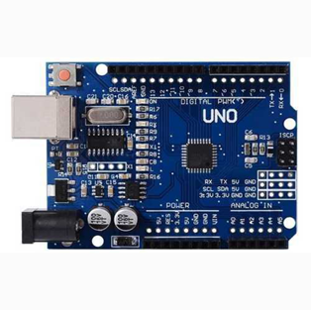
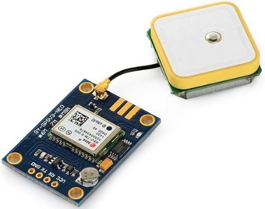
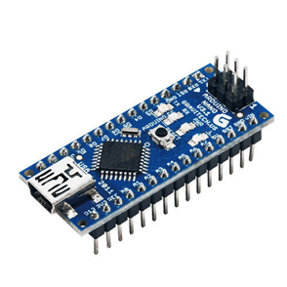
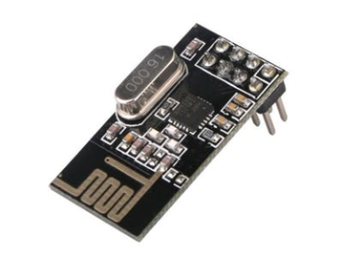
SLIDE 4
TECHNOLOGY STACK
Arduino uno
NRF24L01 RF
Transceiver
GPS Module
HC – 06 Bluetooth
Module

Slide 5
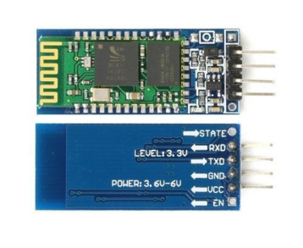
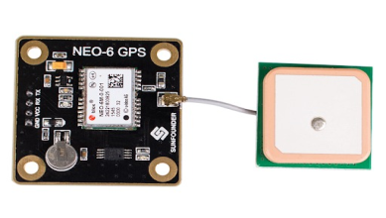
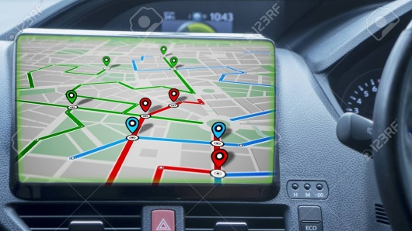
SLIDE 5
BLOCK DIAGRAM
HARDWARE & SOFTWARE IMPLEMENTATION
NRF24L01 RF
TRANSCEIVER
RF of other vehicles
Transmits
Receives the location
HC-06 BLUETOOTH MODULE
ARDUINO UNO
BOARD
Display
MOBILE
GPS
(OR)
GPS
GPS

Slide 6
SLIDE 6
BUSINESS SCOPE
If we launch our device, definitely it's demand will be very high.
It has great scope in transport manufacturing industries.
GPS Module(2) = Rs.568
HC-06 Bluetooth Module(2)= Rs.386
NRF24LO1 Module(2) = Rs.339
Arduino Uno(2) =Rs.1800
TOTAL =Rs .3000

Slide 7
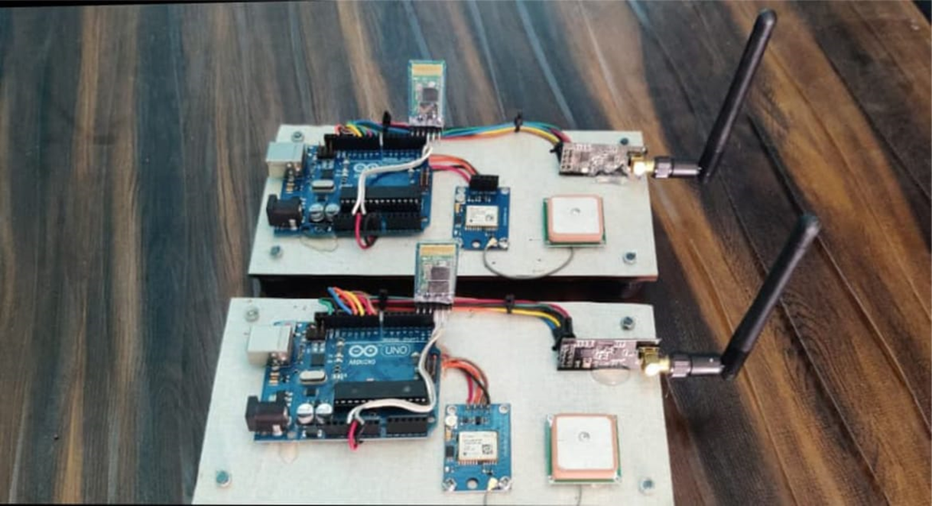
SLIDE 7
OUR DEVICE

Slide 8

SLIDE 8
“Use our device and make your journey safer and happier”
Thank You

